Slide 1
Image Segmentation
Presentation by:-
Vishal Kumar Vishwakarma
Ravi Kumar

Slide 2
What is Image Processing?
Image processing is a method to perform some operations on an image, in order to get an enhanced image or to extract some useful information from it.
It aims at improving the quality of the image as far as visualization is concerned.
In this our input is original image and output is a processed image.

Slide 3
Image Analysis
Image Segmentation
Different Approches –
Discontinuity Based
Region Based
Different Edge Detection Operators
Linking of Edge Points

Slide 4
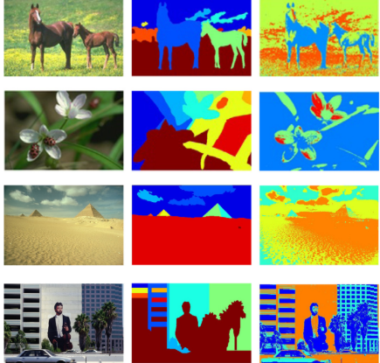
Image Segmentation
A process of subdividing an image into its constituent parts or objects in the image
Aim: Analysing substituent parts or objects once they are divided into objects to extract information.
Conclusion: Information extracted are useful for high level machine vision applications.

Slide 5

Level of Segmentation
Till what extent the image should be segmented?

Slide 6
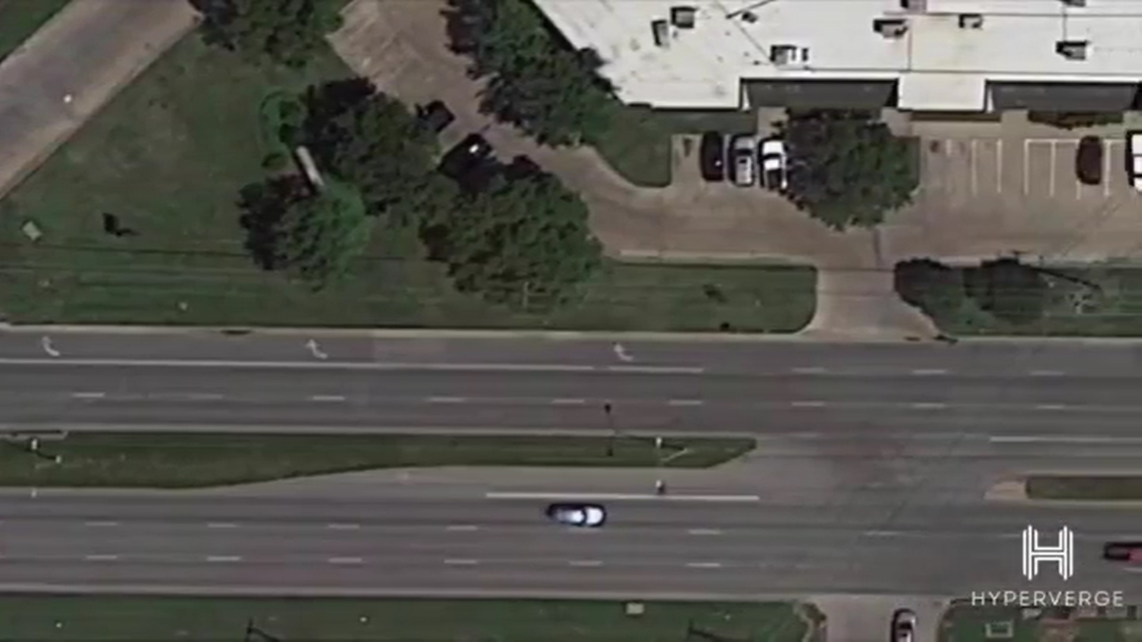
An Example
Detecting the Movement of a Vehicle
To detect movement pattern of different vehicles on Road :Aim
No need of Segmenting this part
(Area of No interest)
We segment this road
Then we segment vehicle

Slide 7
Different Approaches to Image Segmentation
Discontinuity based
Similarity based
Discontinuity Based
The partition or subdivision of an image is carried out on some abrupt changes in gray or intensity level. Here we are mainly interested in say isolated points or identification of lines and edges.
Similarity Based
Here we try to group those pixels in image which are similar in some sense. The simplest approach under this technique is Thresholding.

Slide 8
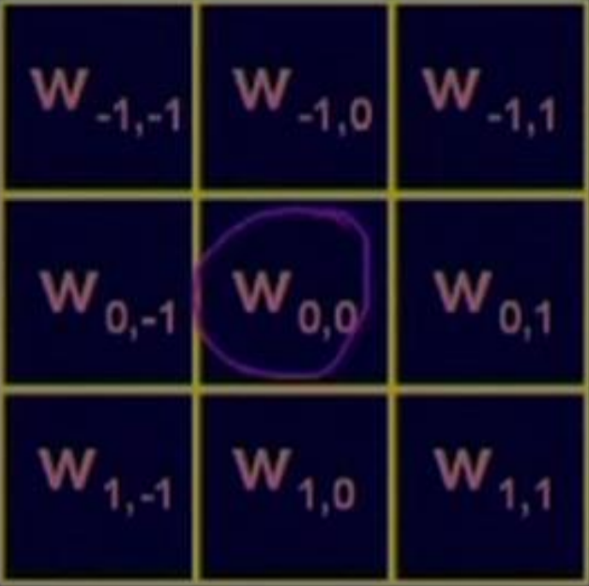
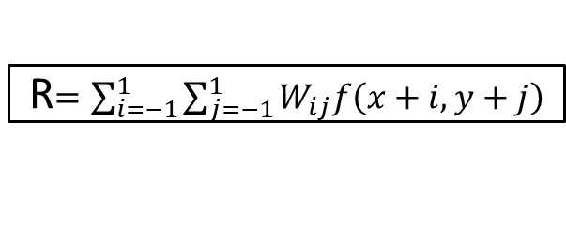
Discontinuity Based Techniques
It is done by using characteristics of variations of intensity values when there is variation of intensity while transition from brighter to darker region or vice versa.
Aim : To detect isolated Points, Lines or Edges using mask
R$=\sum_{i=−1}^{1}{\sum_{j=−1}^{1}{W_{ij}f\left(x+i,y+j\right)}}$
For eg- If all mask coefficient is equal to 1 then this technique will be used for image smoothening.
A point is detected at location (x,y) in an image where mask is centered if corresponding value
|R| > T (non-negative threshold value)

Slide 9
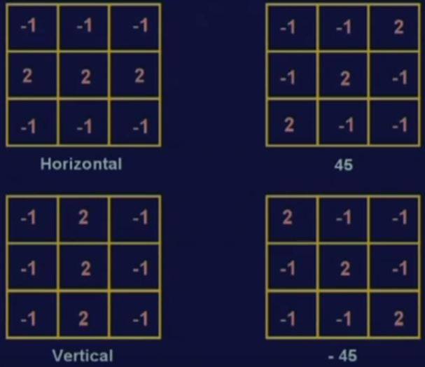
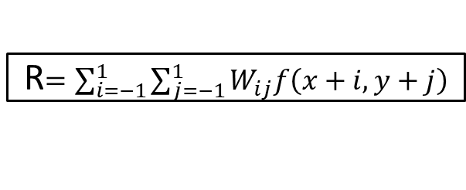
Discontinuity Based Techniques
Line Detection
For Line detection we apply all the four masks, namely Horizontal, Vertical, line inclined at 45 degrees and line inclined at -45 degrees .
The points which are detected using horizontal line detection by mask will contain all points in horizontal direction.
Similarly the same scenario applies for vertical, and other two detections respectively.
R$=\sum_{i=−1}^{1}{\sum_{j=−1}^{1}{W_{ij}f\left(x+i,y+j\right)}}$
Now there is condition which follows that while using masks over entire image, say i_{th} mask or j_{th} mask and if |R_{i}|>|R_{j}| for all i≠j
Then points detected is more likely to be contained on line in direction of mask i.

Slide 10
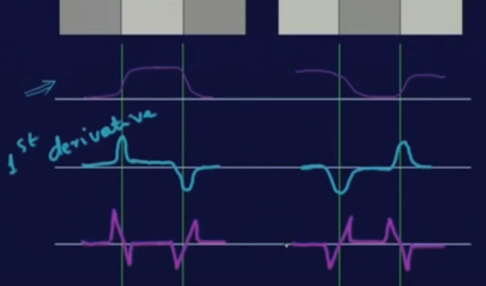
Discontinuity Based Techniques
Edge Detection
It is the most common approach for detection of discontinuity of image.
Edge: It is the boundary between two regions having distinct intensity levels
As shown in the figure given right side, it’s obvious that 1st derivative is positive at leading edge and negative at tailing edge.
2nd derivative
Also 2nd derivative is +ve at darker side and –ve at brighter side
1ST derivative can be found out gradient operation.
R$=\sum_{i=−1}^{1}{\sum_{j=−1}^{1}{W_{ij}f\left(x+i,y+j\right)}}$
However, first derivative is used in detection of edge as a measure of sharp variation or change of intensity value while transition from brighter to darker region and vice versa.

Slide 11
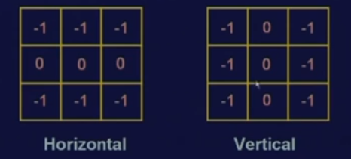
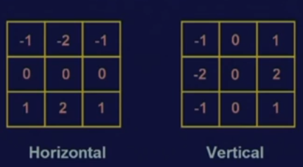
Discontinuity Based Techniques
Edge Detection
First derivative
Second derivative
PREWITT EDGE OPERATOR
LAPLACIAN
SOBAL EDGE OPERATOR
Prewitt operator uses two masks one identifying horizontal edges anther vertical edges.
Prewitt operator uses two masks one identifying horizontal edges anther vertical edges.
PREWITT MASKS
SOBAL MASKS

Slide 12
Discontinuity Based Techniques
Edge Detection
FIRST DERIVATIVE VS SECOND DERIVATIVE
On compairing first derivative with second derivative, first derivative is used for edge detection.
With second derivative operator , the problem is it is very sensitive to noise so less preferred.
However, it is used to collect secondary information like exact location of edge and also determine whether point is belonging to darker side or brighter side by looking at the sign by using 2nd derivative operator.
2nd derivative

Slide 13
Similarity Based Segmentation
THRESHOLDING TECHNIQUE
REGION GROWING TECHNIQUE
REGION GROWING TECHNIQUE
GLOBAL THRESHOLDING
DYNAMIC THRESHOLDING
OPTIMAL THRESHOLDING
LOCAL THRESHOLDING

Slide 14
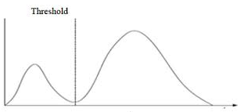
Similarity Based Segmentation
HOW TO USE THIS TECHNIQUE??
Let us assume an image f(x , y) by two dimentional function. Assuming that image brighter object against darker background or vice versa.
So we plot histogram of such an image say brighter image against darker background.
Now choose Threshold value T and follow the following criteria:
if intensity at location (x ,y) of :
f(x ,y) >T ( pixel belongs to object)
f (x, y) <= T (pixel belongs to background)
Bimodal histogram peaks
=T
h(z)
z
Valley region

Slide 15
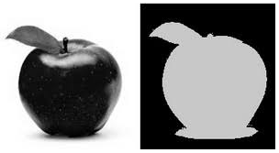
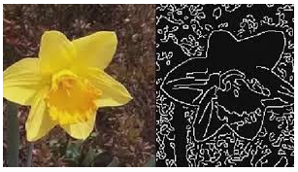
Similarity Based Segmentation
CRITERIA FOR THRESHOLDING OPERATION USING VARIOUS TECHNIQUES
The Thresholding value of thresholding operation can be considered as an operation that involves testing against a function T:
T=T[x y ,p(x, y), f(x ,y)]
x , y pixel location, f( x, y) pixel intensity at (x,y) p(x ,y) local neighbourhood property
If T[x ,y] =Global thresholding If T[f(x, y) , p(x, y)]= adaptive thresholding if T[x, y ,f(x , y), p(x , y)]=local thresholding
Finally image obtained by thresholding is thresholded image g(x ,y) =1 for object pixel and 0 for background.

Slide 16
Similarity Based Segmentation
AUTOMATIC THRESHOLDING
Initialize the value of T
Group the pixels in two groups G1 and G2 based on Threshold value T.
Find µ1 and µ2 such that µ1 = average intensity of G1 & µ2 = average intensity of G2
Set T=(µ1+ µ2)/2
Repeat the steps from 2 to 4.

Slide 17
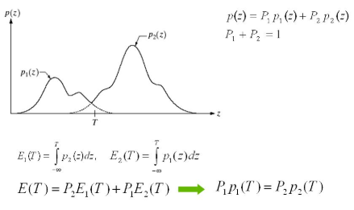
Similarity Based Segmentation
OPTIMAL THRESHOLDING
Till now we studied various thresholding techniques for segmentation but none of the processes talked about the accuracy of the thresholding. Optimal thresholding solves this problem.
We considered the image having a brighter object against a darker background, the histogram of which is shown here.
And it is depicting two regions as a combination of two PDF(probability density functions).

Slide 18
References
http://nptel.ac.in/courses/117105135/
A multilevel image thresholding segmentation algorithm based on two-dimensional K–L divergence and modified article swarm optimization by Xiaoli Zhaoa,c,∗, Matthew Turk b, Wei Li d, Kuo-chin Lienb, Guozhong Wanga
Multilevel thresholding for image segmentation through a fast statistical recursive algorithm by S. Arora , J.Acharya , A. Verma, Prasanta K. Panigrahi
https://en.wikipedia.org/wiki/Image_segmentation
https://www.cs.auckland.ac.nz/courses/compsci773s1c/lectures/ImageProcessing-html/topic3.htm
https://courses.cs.washington.edu/courses/cse576/book/ch10.pdf

